Slide 1
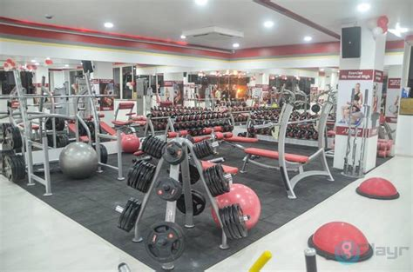
ISTA Project
Fitness tracker

Slide 2
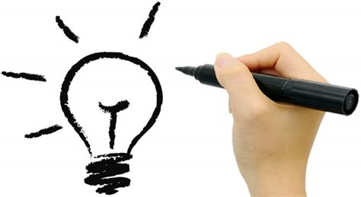
Concepts
Develop a fitness app that can connect to your smartphone or smart watch
accept inputs regarding a persons age, weight , height, and gender
Use existing fitness algorithms to develop user profile
Accept input from smart devices to gauge a persons activity level throughout the day
provide lifestyle recommendations as far as a meal plan for that day based on that days activity and a workout for the day.
The goal of this app is to make a person aware of their imbalances as well as to make nutritional recommendations. An example of this is practice might be something along the lines of inputting your workout for the day and the app then displacing the metrics of that workout vs yesterday’s workout and track progress

Slide 3

Requirements
The requirements for my project are a database can be linked to a gui perhaps through a cloud application. Database should contain all skeletal muscles in the human body, which could then be further classified into major groups that operated in conjunction with one another. Ex) posterior chain, anterior chain, etc.
Additionally I wanted to create a database of common food items to allow a user to track their meals and all relevant nutritional information. Ex) 8 oz chicken breast- 281 calories, 42g protein, 11g fat, 0g carbs
Daily database of activity and amount of food/nutrients consumed
The gui would need to be aesthetically pleasing and provide users with a streamlined method for input their physical attributes as well as their daily nutritional and workout information.
Additionally the gui needs to provide feedback as far as recommendations and imbalances in the users lifestyle.

Slide 4
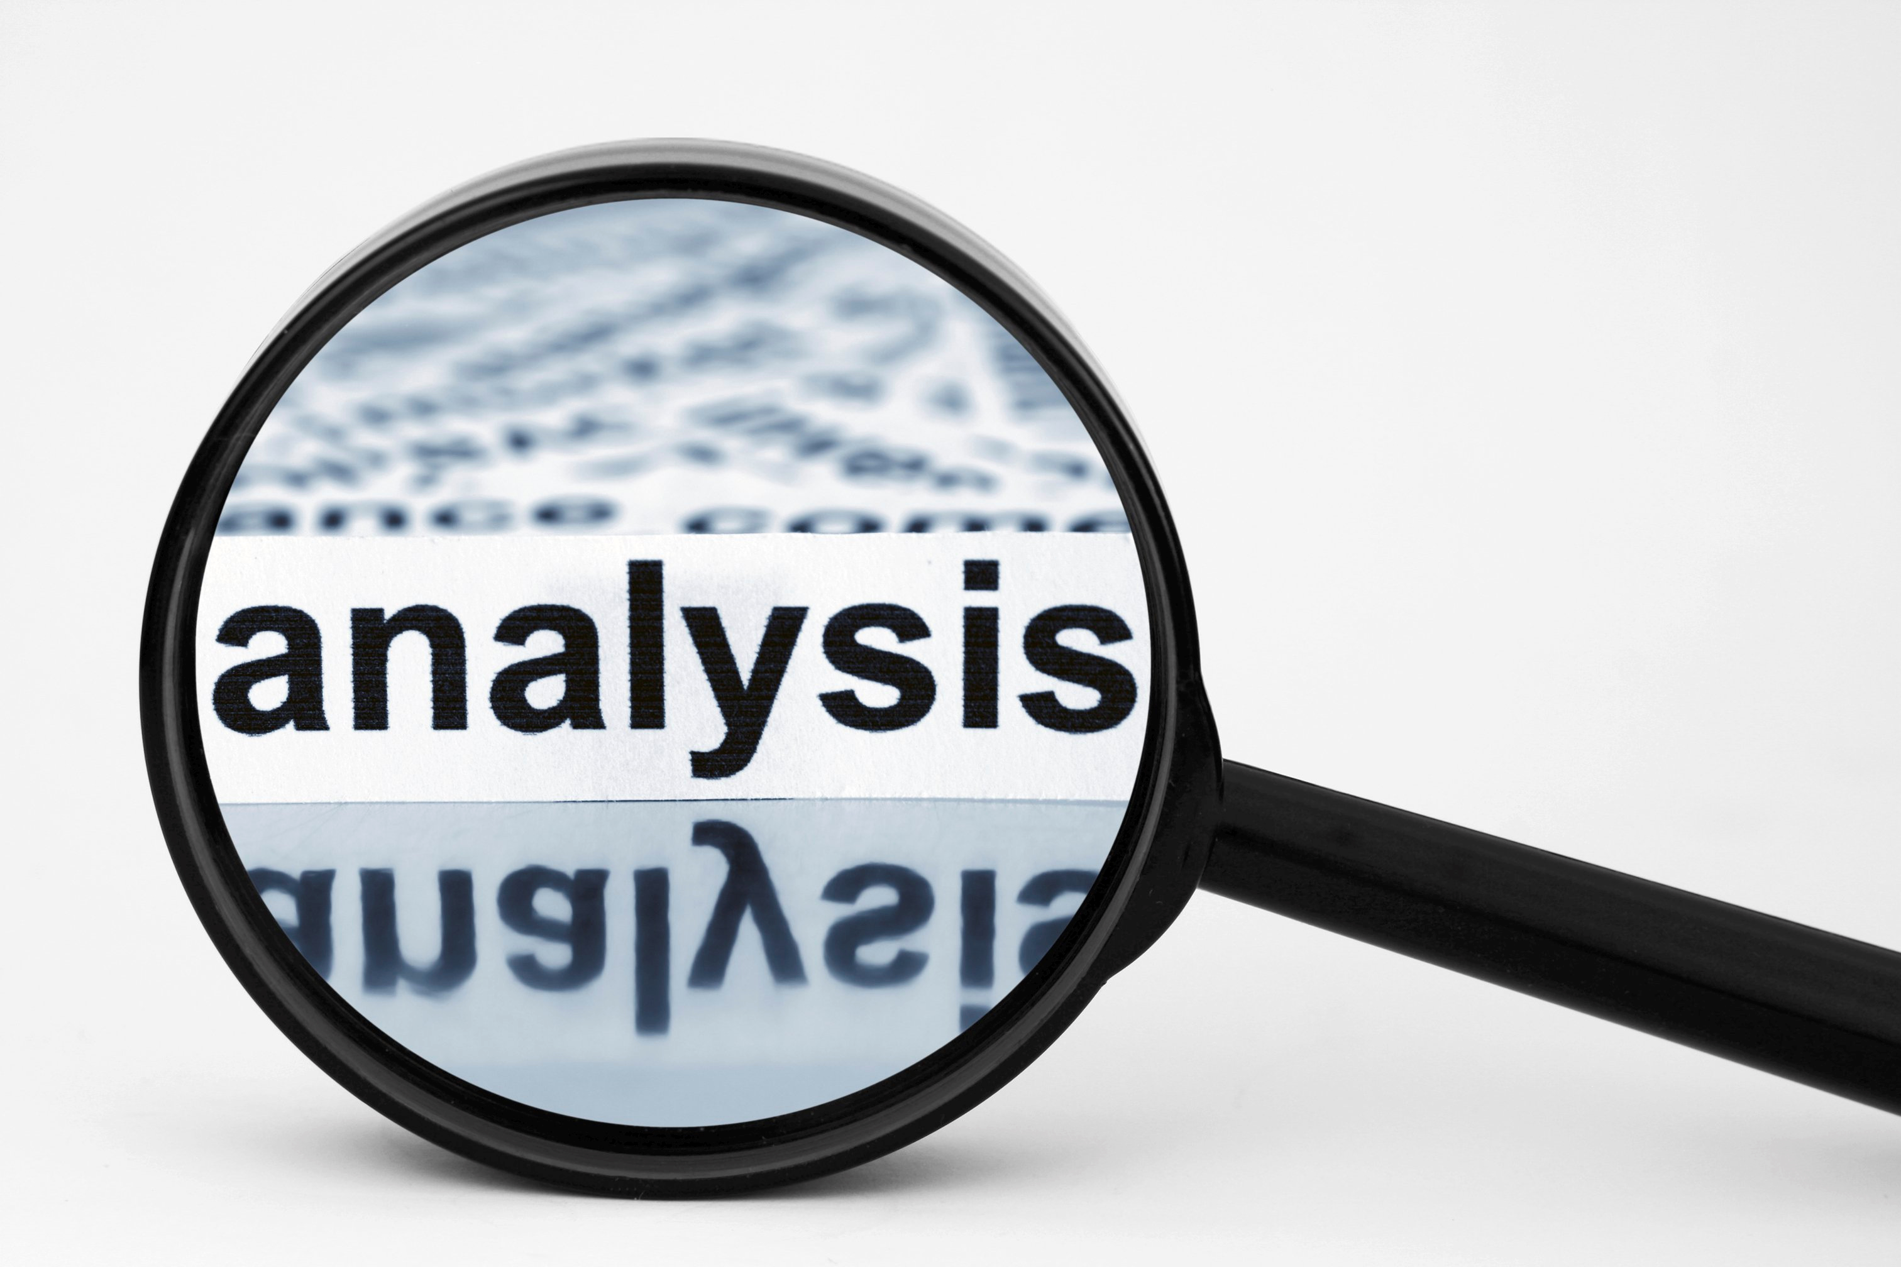
Analysis/design
App needs to be able to be accessed through mobile device
The gui would allow for user inputs and provide lifestyle recommendations as far as a meal plan for that day based on that days activity and a workout for the day.
Database will contain relevant muscle groups and nutritional information
Allow users to add foods to database
Cloud storage ? Ideally, user profile would be stored on the cloud to allow user to use same profile on different devices, lost phone, etc.

Slide 5
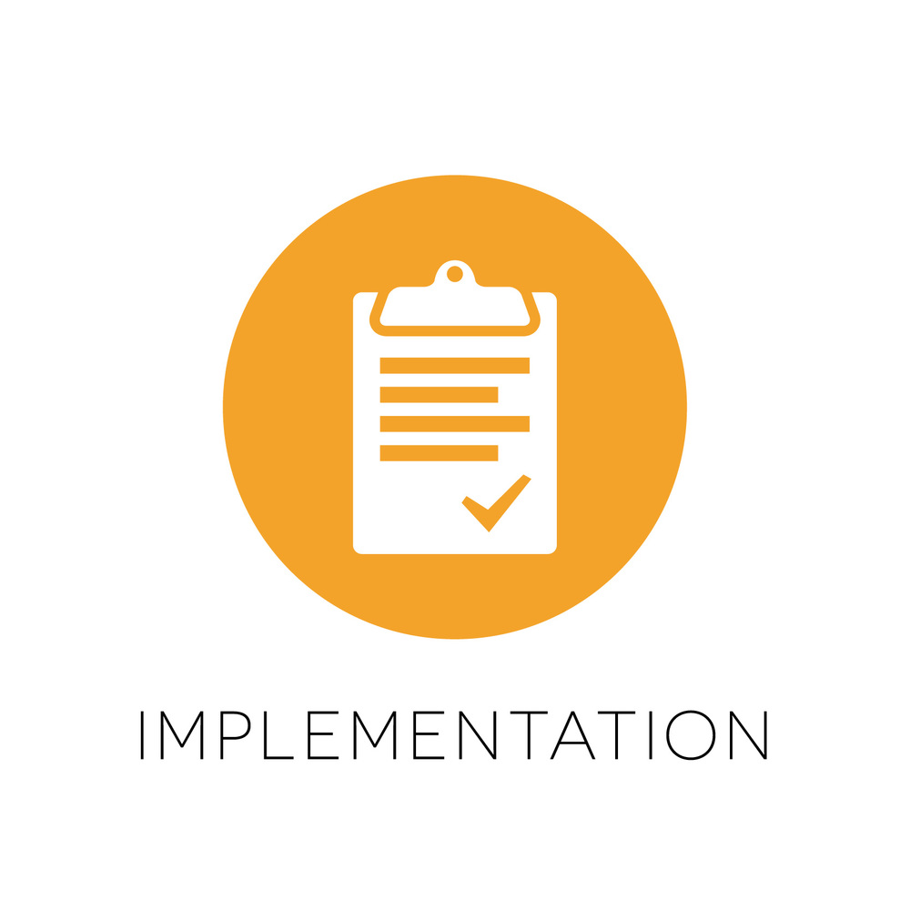
Implementation
The implementation of this idea would involve building the actual database using SQL and coding the gui.
Use existing fitness data to determine which workouts target which muscle groups
Use existing nutritional information and user input to create a database of common foods
The key to success in this phase would be dividing up the work into modules instead of attacking it all at once.

Slide 6
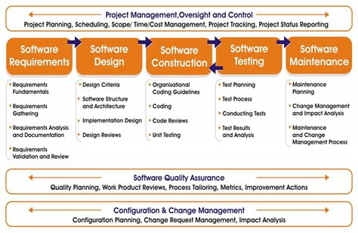
Testing
The best way to test this app would be for to use it in everyday life, correcting exceptions as they appear and adding more data to the databases with the increase in users.

Slide 7
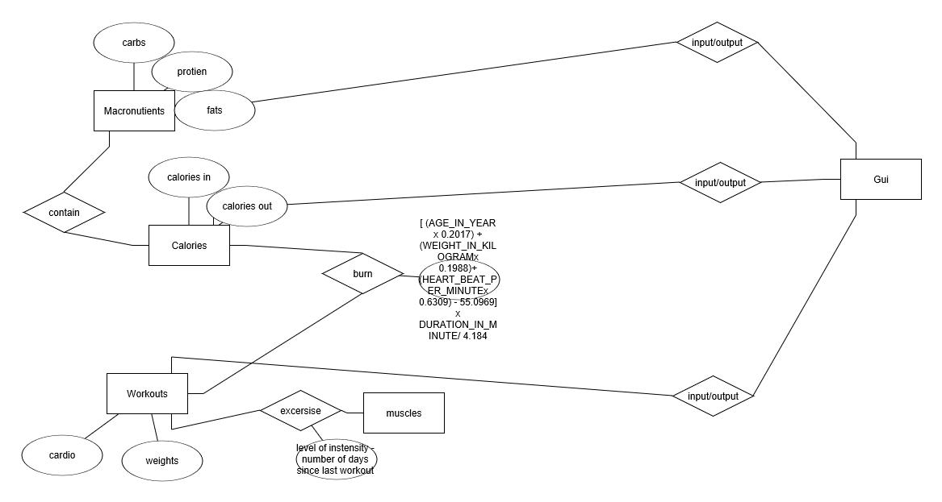
ERD

Slide 8
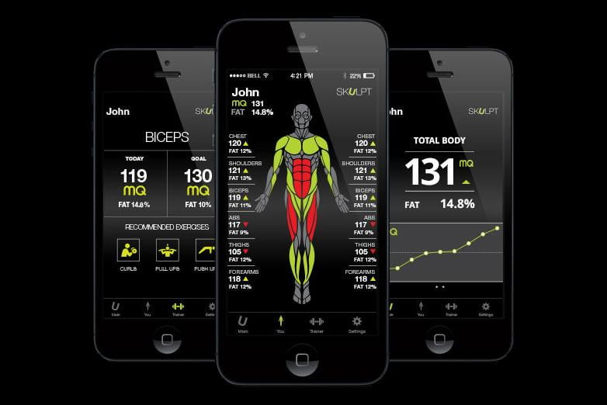
What could have been

Slide 9
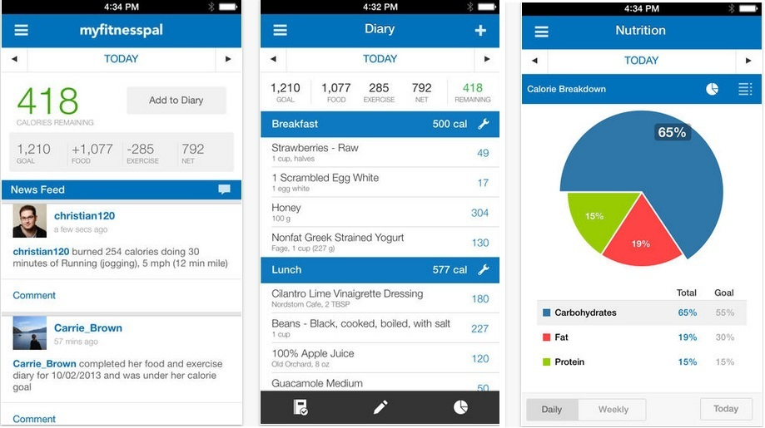

Slide 10
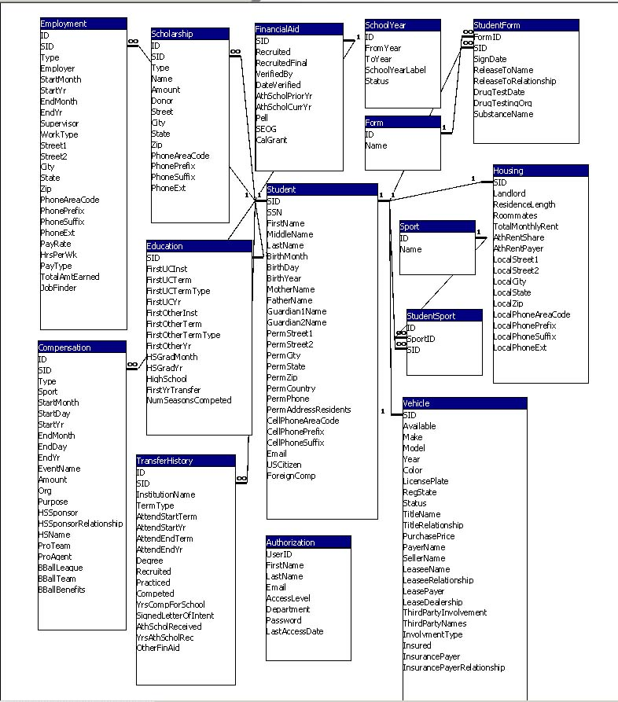
Database Implementation

Slide 11
Takeaways
Software development is hard!
Choose smaller projects to match skill level
Work in teams
“Read the F***ing manual”
Its hard to come up with an original idea, so much has been done already

